Slide 1

Group 3
Dirk Thieme, Erik Manis, & Mohammed Ansari

Slide 2
Rover Mini Project
Summary:
Goals:

Slide 3
Last Week's Tasks
Soldering Tutorial
Choose a circuit simulator
Get a Workbench
Get an H-bridge
Watch Vivado tutorials
Set up a file sharing system

Slide 4
Completed Tasks
All: Admin requirements complete
Motor demo project
Dirk: Gantt chart
Mohammed: Budget
All: Software downloaded
Erik: Project notebook setup
Mohammed: Rover chassis

Slide 5

GitLab

Slide 6
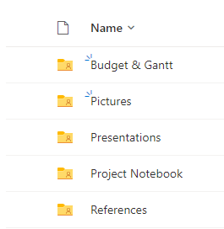
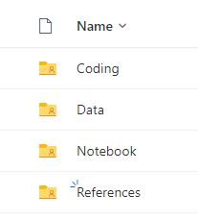
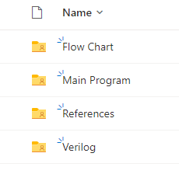
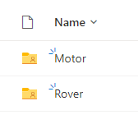
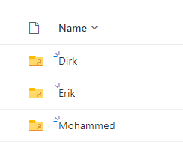
Project Notebook

Slide 7
Schedule Changes
Soldering tutorials
The classes for this are tomorrow and next week
Mohammed plans to attend tomorrow
Dirk and Erik plan to attend next week
Verilog tutorial Videos
None of us finished the videos
Starting work on the rover
We do not have the parts in our possession yet

Slide 8
Next Week's Tasks
Getting the parts in
Try putting parts together
Start programming for the motors

Slide 9
Budget Update
We have a budget?

Slide 10
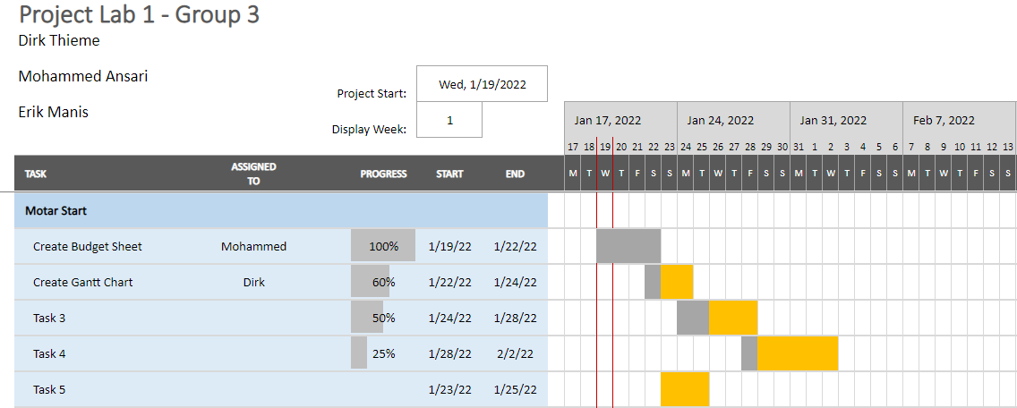
Gantt

Slide 11
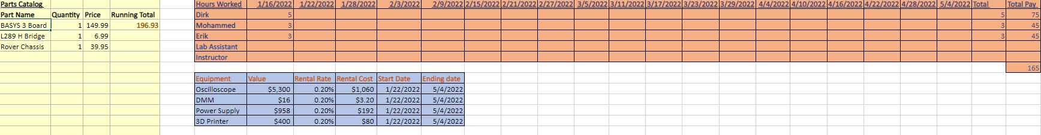
The Budget

Slide 12

Questions
Group 3
Dirk Thieme, Erik Manis Mohammed Ansari
This Photo by Unknown author is licensed under CC BY.

